Slide 1
Accessibility Resource Center
Will.Power.
Notes:
Hi. Welcome to the Virtual Orientation for the Accessibility Resource Center. My name is Joy Durham and I serve as the Director of the office. I’m excited to have the opportunity to tell you about our office and the support we provide.

Slide 2
What do we do?
The Accessibility Resource Center provides accommodations for students with documented disabilities (e.g. - learning, psychological, medical or temporary).
We work with campus partners, including faculty, to reduce potential barriers to access and to promote inclusion.
Our name was changed from the Office of Disability Services to the Accessibility Resource Center in 2018 to reduce the stigma of students identifying with our office.
Will.Power.
Notes:
After 1st bullet- We don’t focus on the name of the disability or condition- we focus on the impact it has on the student.
After 2nd bullet- For example, we work with facilities to ensure that they are aware of elevators that need to be repaired. We work with faculty and staff to provide closed captioning to videos we publish online. Accessibility is not limited to accommodations- it is a campus wide effort.

Slide 3
Misconceptions about our Office
We are not a specialized program or a department for special education.
We do not provide tutoring services, but we do collaborate with academic support services and connect students to campus resources.
We are not connected with the admissions office and do not know if a student has a disability, or needs accommodations, unless the student self-identifies.
Will.Power.
Notes:
After 1st bullet- There are students who may have had IEPs or special education during their K-12 experience- it is important to note that receiving accommodations from our office is NOT special education. All students have to meet the same academic standards at WPU.
After 3rd bullet- This is an important point that I want to highlight. This is a common misconception- if a student had an IEP or 504 plan in high school, it is not part of their educational record or high school transcript. Admissions has no way of knowing if a student has a disability unless the student self-discloses in some way. Those records do not automatically transfer to the university so it is very important that students self-disclose that they have a disability with our office as soon as possible, in order to receive the accommodations and support they may need.

Slide 4
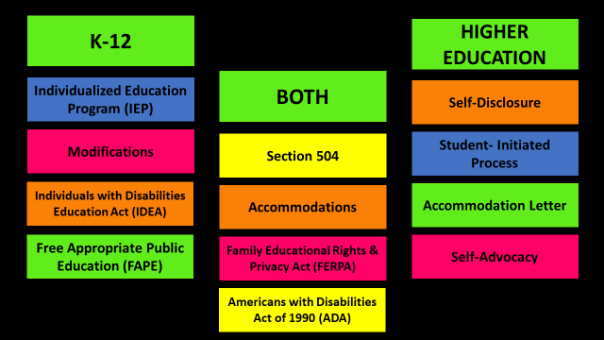
K-12 vs. Higher Education
Will.Power.
Notes:
I created this slide to point out some of the differences between a student’s K-12 experience versus higher education.
You’ll notice that on the K-12 side, it mentions IEPs, the IDEA (which is the law that ensures that students with a disability are provided with a free and appropriate public education) and modifications. I want to focus on modifications- Modifications are changes to WHAT the student is being taught. For example, a student who struggles with reading may get reading material that is below their grade level to build their skills. In higher education, all students have to meet the same academic standards so rather than changing WHAT the student is learning, we adjust HOW the student accesses the material and how they learn in the classroom, through the use of accommodations.
On the higher education side, you see “self-disclosure” which means that the student must disclose to someone at the university that they have a disability. We encourage students to directly disclose to our office in order to protect their confidentiality. However, if they disclose to a professor or an advisor, they will be directly referred to our office.
Another important point is that once students are approved for accommodations, they are provided with an Accommodation Letter. The letter does not state the type of disability (see next slide) and simply states the accommodations the student has been approved for with a brief description.

Slide 5
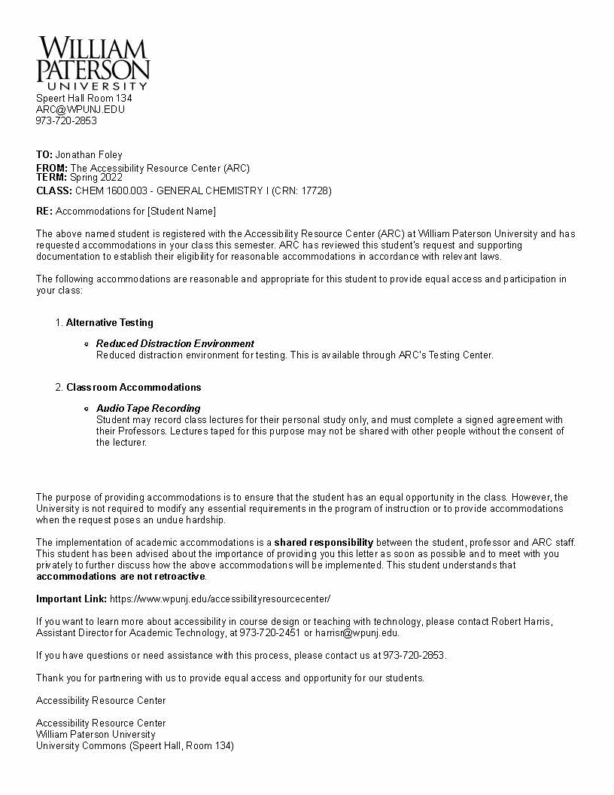
Letter of Accommodations (sample)
Will.Power

Slide 6
Examples of Accommodations
Extended time on exams | Use of a scribe or reader
Use of a computer or laptop for exams | Note-taking
Reduced distraction testing location | Permission to record lectures
Assistive technology | Use of a calculator (when appropriate)
Will.Power.

Slide 7
Accommodations Process
Complete the online Student Application (found on our website)
Provide appropriate documentation related to the impact of the disability.
Attend a Welcome Meeting with Accessibility Resource Center staff.
Receive notification about accommodation decision from Accessibility Resource Center.
If approved, provide Accommodation Letter to professors.
Will.Power.

Slide 8
Barriers to Access
Everyone is going to know that I need help!
Can I do this on my own?
What will my professors think?
What services and accommodations can I get?
Will I be getting an unfair advantage?
What will other students say?
Will.Power.
Notes:
We have found that there are some barriers to access that students face when they are trying to determine if they will self-disclose to our office. Some of them are- (read the bubbles)
If you feel any of these, you are not alone. We are here to answer any questions or concerns you may have and help you to navigate the process. Remember, you deserve the opportunity to not just “get by” in college- you deserve the opportunity to thrive.

Slide 9
Virtual & In-Person Access
Virtual Meetings (Microsoft Teams) or In-Person Meetings
Hot Topics
Welcome Meetings
Placement Tests
Accommodation Requests
GA Mentoring Sessions
We are working and available to support you!
Student Resources - FAQs, tips, and links to make each semester more manageable.
Faculty Resources - Important information for how to better assist students with accommodations.
Will.Power.

Slide 10
Accessibility Resource Center
Maria Block, Accessibility Specialist
Megan Searles, Accessibility Specialist
Kelly Farrell, Program Assistant
Shannon O’Brien & Emily Maksoud, Graduate Assistants
Speert Hall #134
(973) 720 - 2853
https://www.wpunj.edu/accessibilityresourcecenter/
Will.Power.

